Slide 1
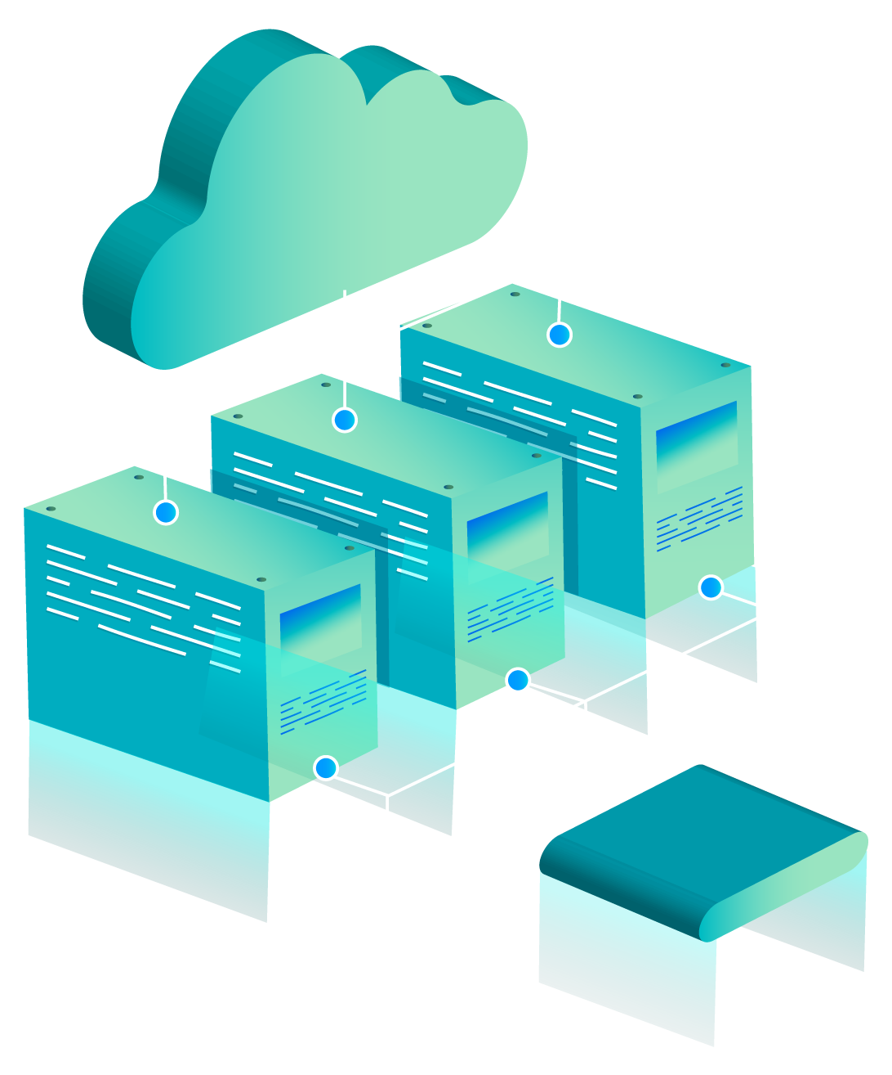
Case Study:
Elbe-Werkstätten & Microsoft Powers APP
Hoang Le
Franklin Ledesma
Ricardo Torres

Slide 2
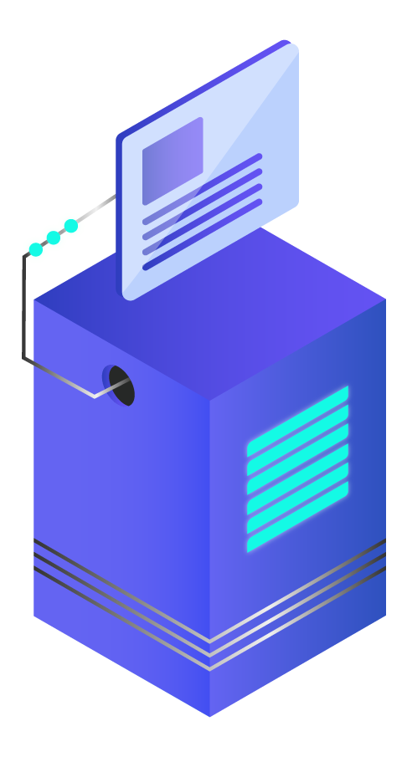
INTRODUCTION
Elbe-Werkstätten, a health service provider in Germany that offers people with disabilities assistant, had a business problem of paper-based processes, protracted workflows, and indirect collaboration and had a big need for digital transformation.

Slide 3
Cloud Services Research
GetMyTeam
Application on Central Administration
Standardized Processes
Based on Azure Logic Apps( AI-legacy), Powers Apps(integration solutions) and Power platforms (low-code)
Microsoft Old Services
Only used this before:
Teams, Excel, Word
A lot of paper-based processes
Exp: PK99 Application by hand
SharePoint Online
Employee portal
Information, such as job offers or the cafeteria menu.

Slide 4
Technical Insights
Data Integration
Data Privacy
Facilitates the seamless integration and digitization of internal processes
Exp: PK99 and agenda app
Data hosted on the company tenant
Data Protection
In the future
GetMyTeam displays any potential compliance breaches.
Less prone to paper-based error/mishaps
MemberCentral App

Slide 5
Business Impact
Collaboration Improvement
Inclusion
Collaboration in real time
Cut down on a lot of processing/approvals time
A new Team can be approved and set up in just five minutes, which means employees can get going right away
Power Apps low-code approach
→ Allows for people with no code knowledge
Improve the process without “placing any digital obstacles in our employees’ way”

Slide 6
THANKS!

